Slide 1

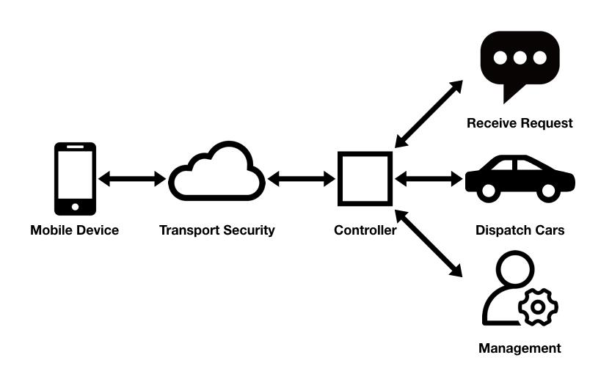
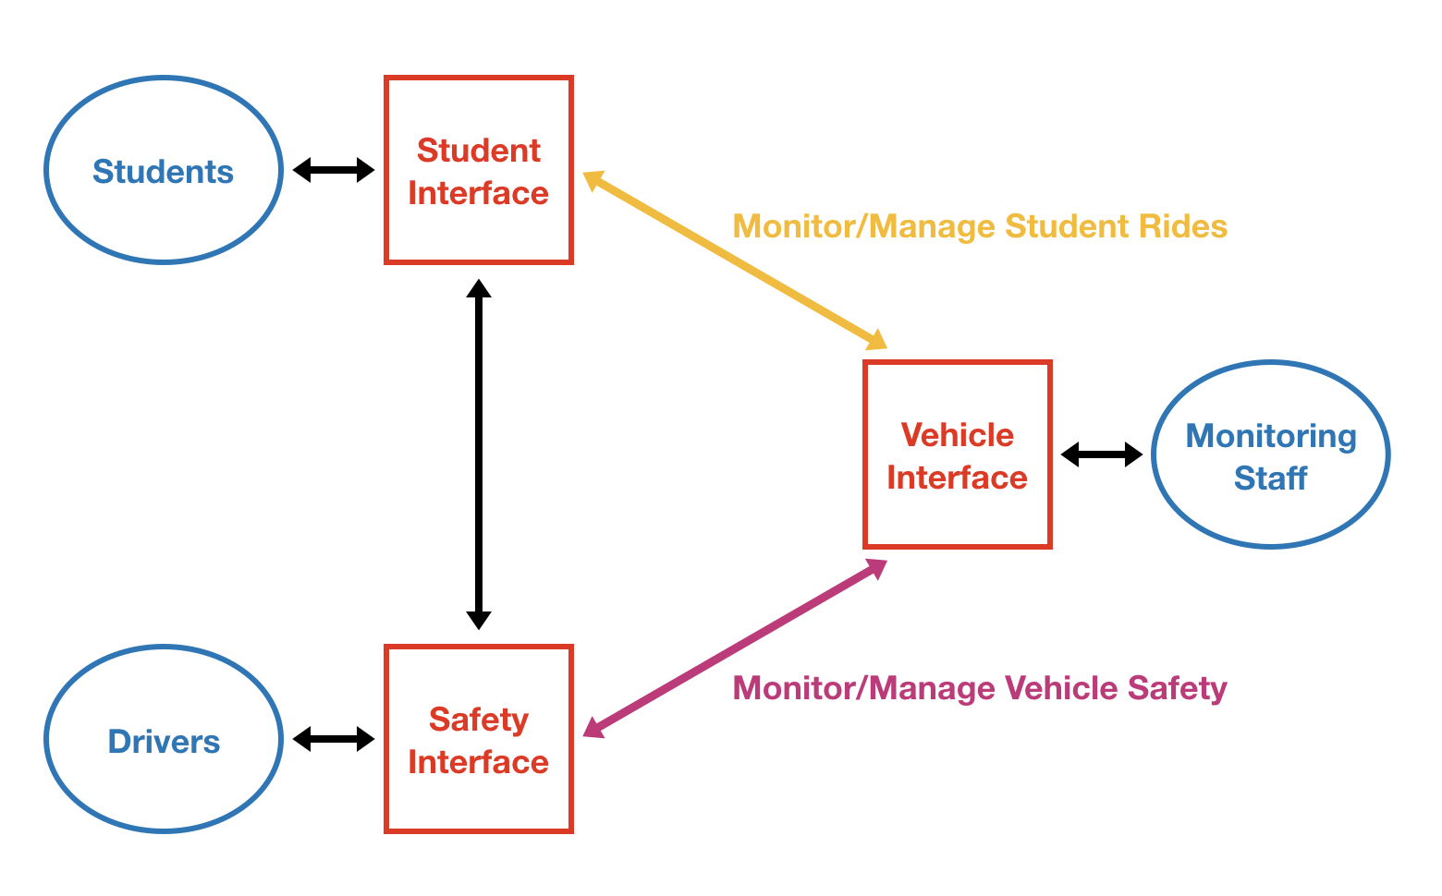
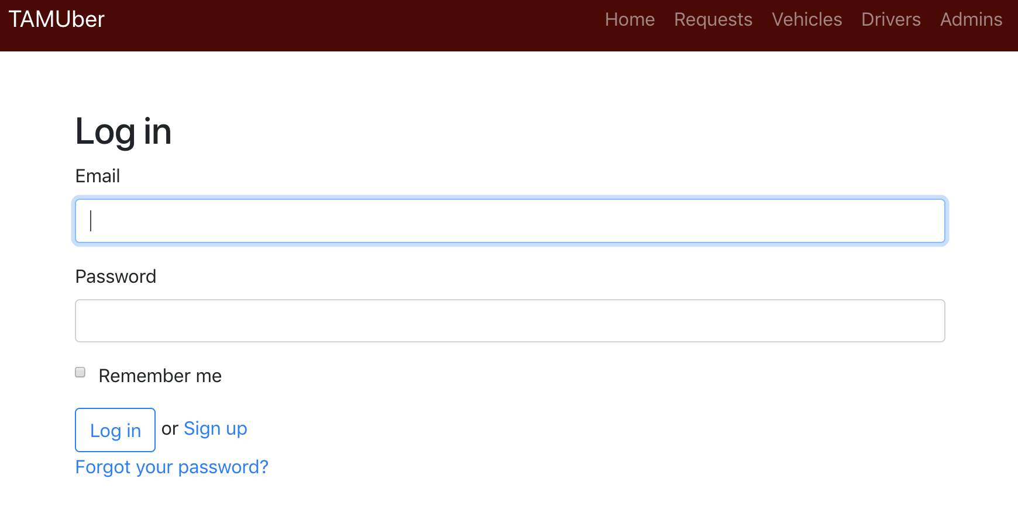
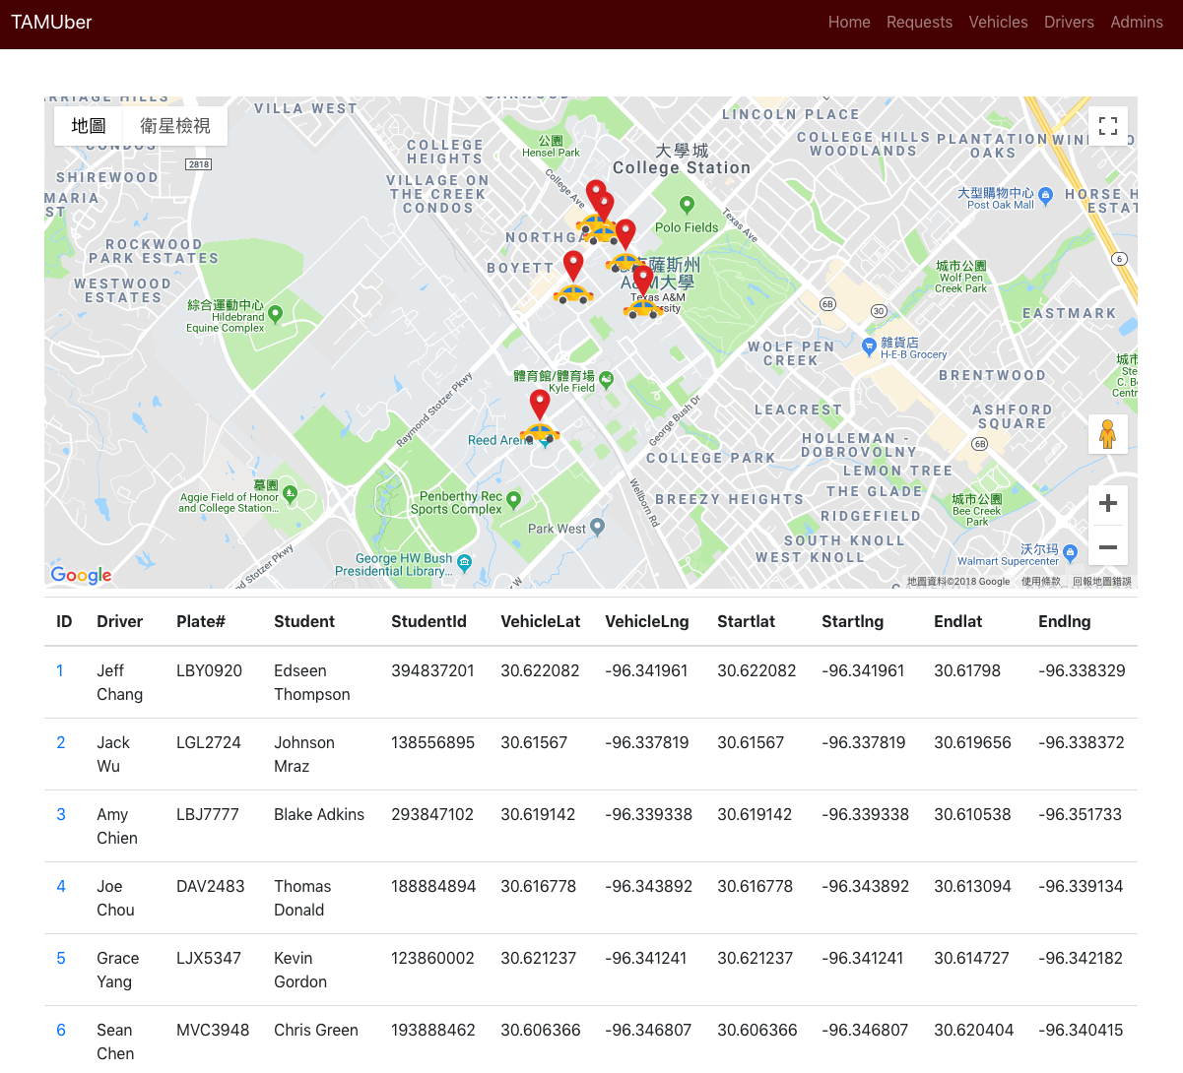
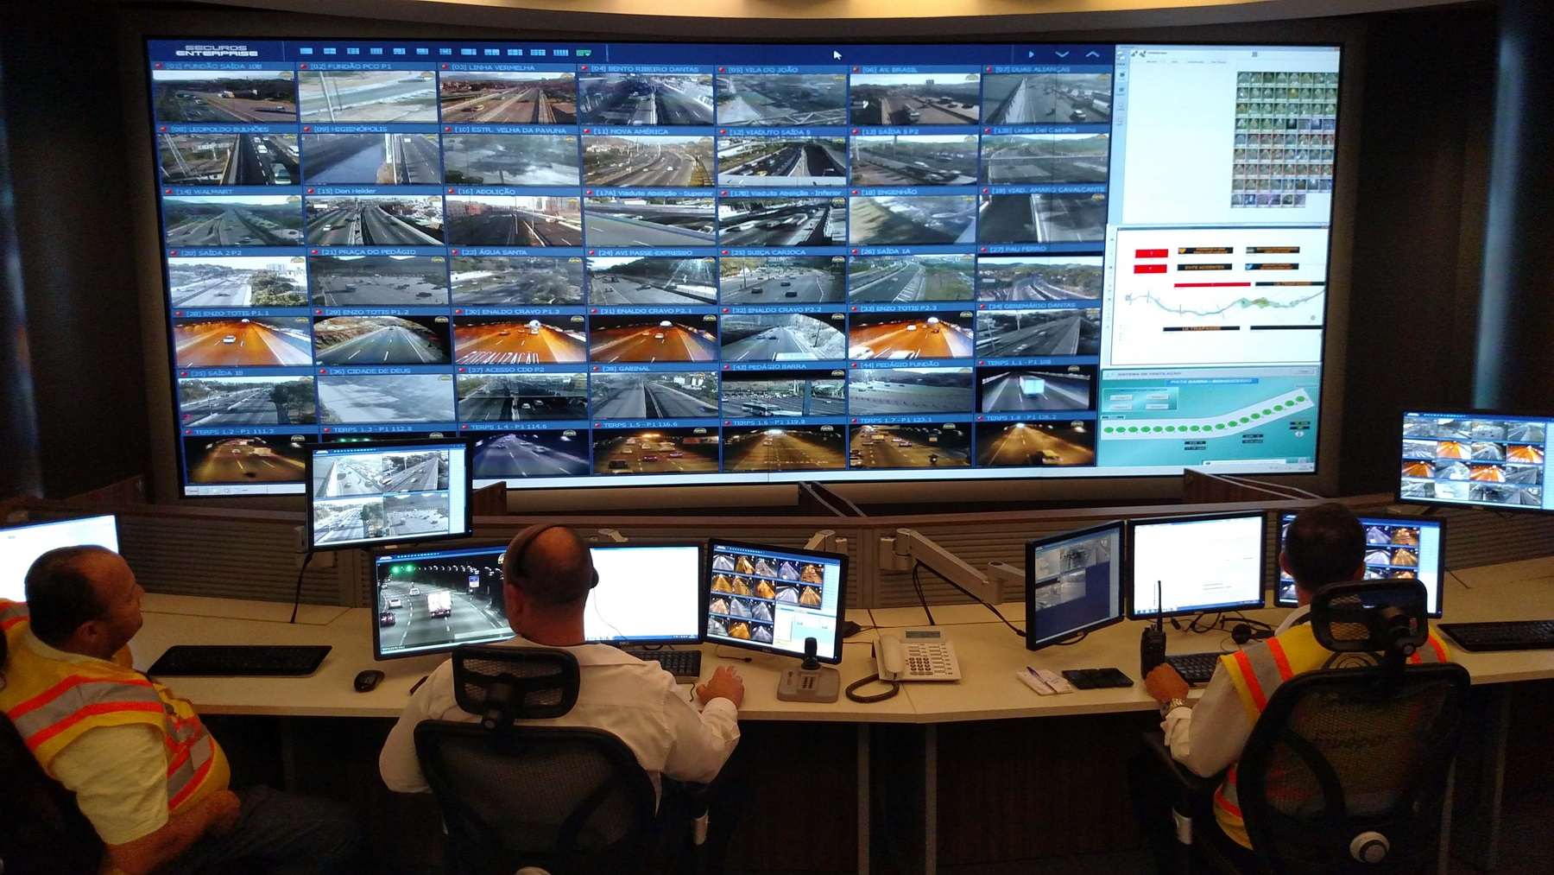
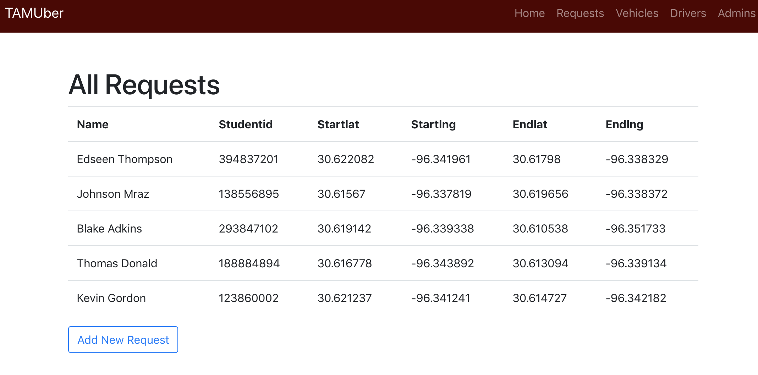
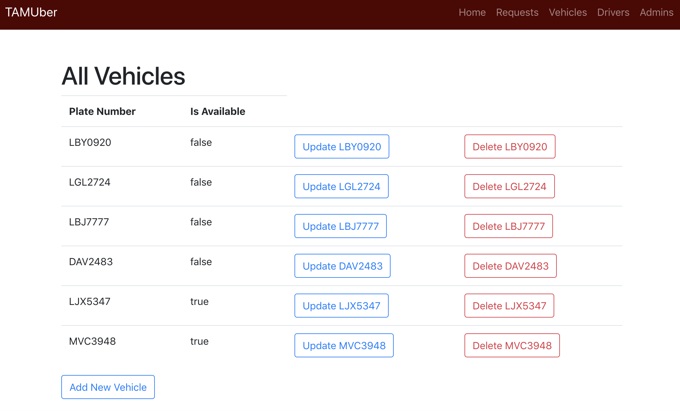
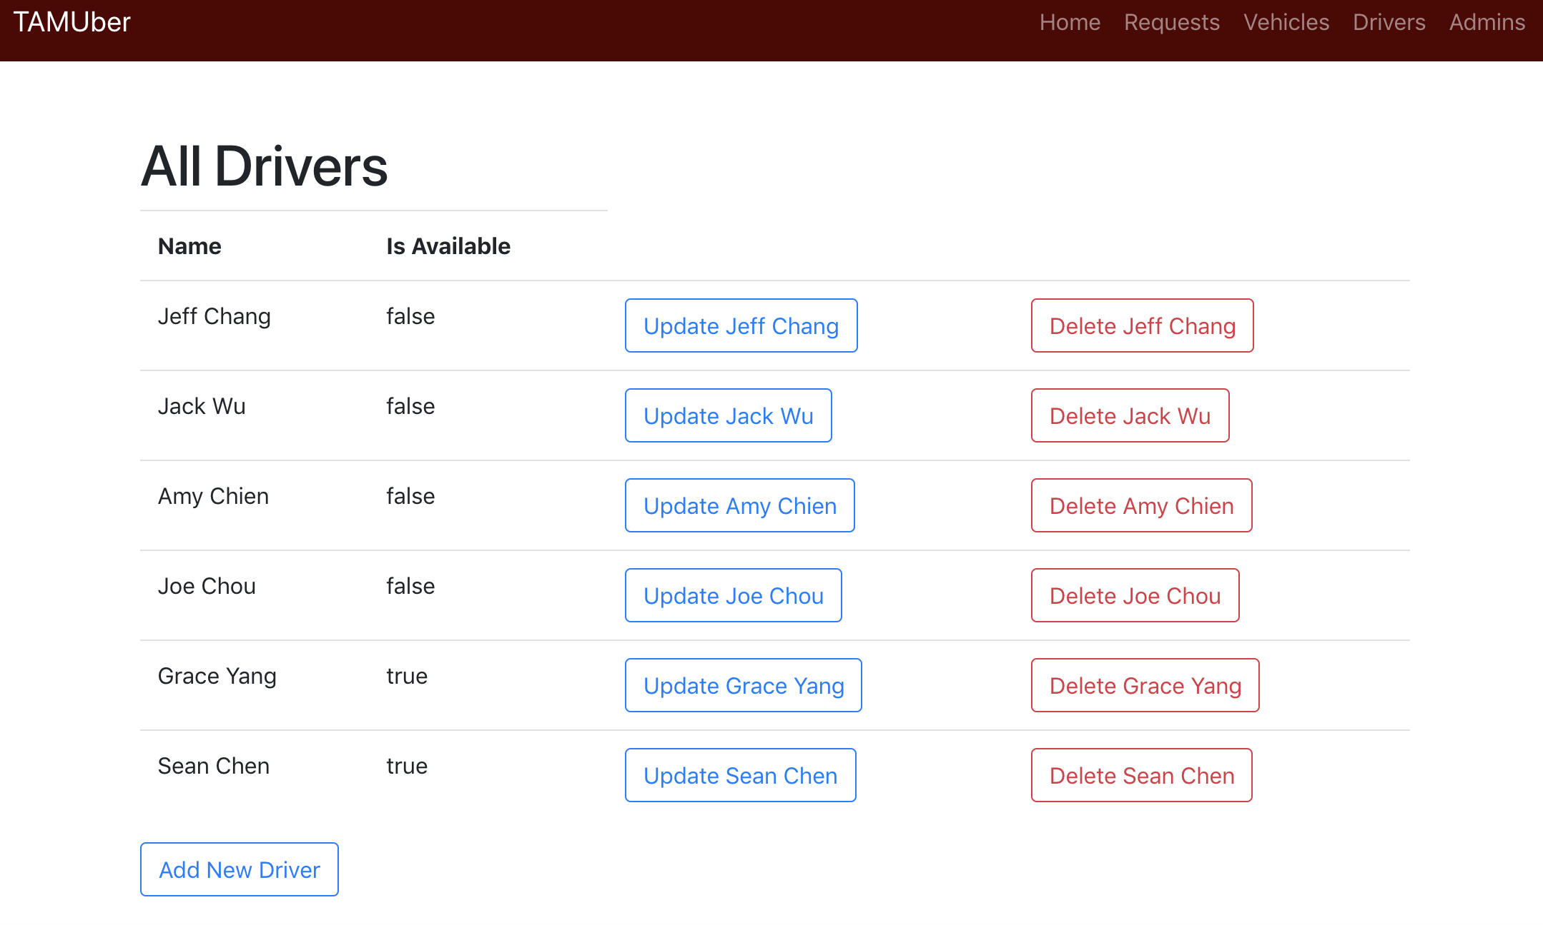
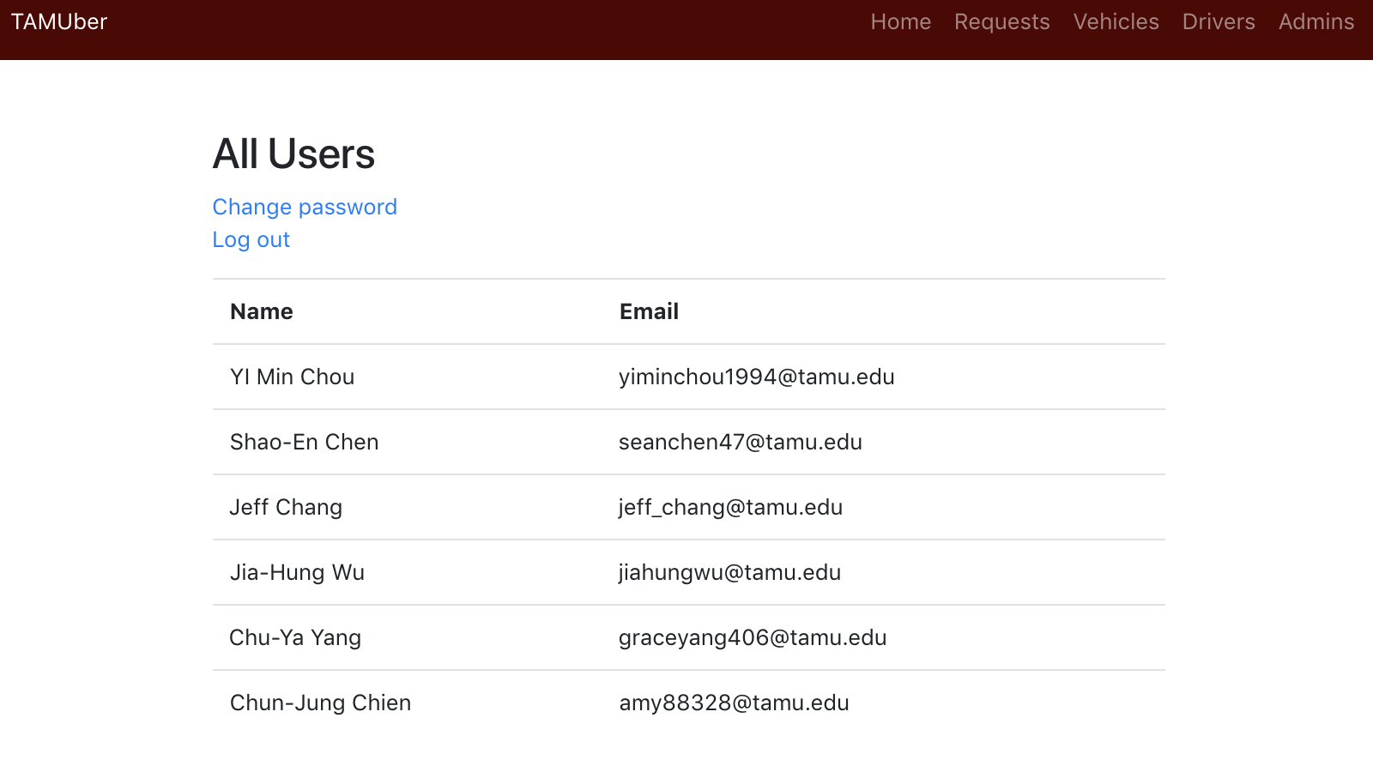
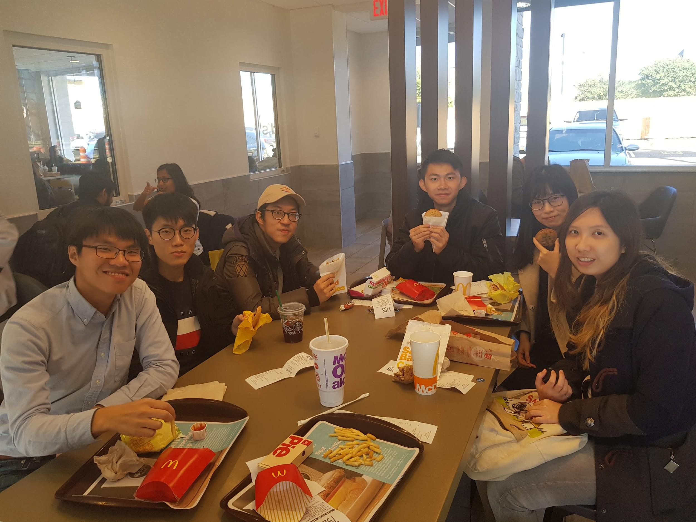
Howdy
TAMUber!
Vehicle Team
Where Convenience Meets Campus
INTRODUCTION
People with disability or mobility disadvantages need to get a free ride in school for classes, otherwise this inconvenience might infringe their educational opportunity. In light of this situation, Texas A&M University wants to bring transportation service on campus. With TAMUber solution, we easily arrange an available driver and vehicle to give a ride for users to designated location. We also provide a convenient vehicle monitoring system for transportation administrators and drivers, to check the status of other admins, drivers, vehicles, and users’ requests, and see where the drivers and passengers are for safety reasons.
LOGIN PAGE
This page allows administrators to sign in/up in TAMUber monitoring system.
1
MONITORING PAGE
In monitoring page, we present current locations of vehicles with car icons on the map. When administrator move the mouse cursor onto car icons, a brief information box would show up.
At the bottom, monitoring staff can see a complete list of current dispatched vehicles with information of users’ requests.
1
2
3
4
5
Map
Satellite Map
2
REQUESTS
In this page, we present requests sent by users. Information includes users’ name, id, request timestamp, and start/end location.
3
4
5
VEHICLES
This page shows information of all vehicles, including plate number and available status. The administrators can create, update, and delete vehicles on this page.
DRIVERS
This page shows information of all drivers including names and available status. The administrators can create, update, and delete drivers on this page.
ADMINS
This page shows all administrators’ basic information including names and emails. The administrators can change their password or log out.
TEAM MEMBERS
Shao-En Chen Jeff Chang
Jia-Hung Wu Yi-Min Chou
Chu-Ya Yang Chun-Jung Chien

